Slide 1



Group 10
GROCERY PRICING & DEMOGRAPHICS:
Exploring the Relationship Between Grocery Prices, Product Availability, and Socioeconomic Factors

Slide 2

Personal Background
My name is Ian Auger, and I am the sole member of this team. My background is deeply rooted in the food industry, where I spent nearly a decade working in and managing restaurants. After transitioning out of the restaurant space, I spent the past six years working in food technology companies, initially in Operations and Strategy, and more recently as a Data Analyst.

Slide 3

Project Introduction
Project Objective
This project aims to acquire, integrate, and process datasets that enable an analysis of grocery product pricing, product availability, and socioeconomic conditions. The goal is to construct a clean, structured dataset that facilitates future analyses of pricing disparities and access to affordable groceries across different communities. In order to limit the scope of the project, this analysis will focus solely on Egg and Bread products, since these are considered to be cheap and readily available to American consumers, as well as a staples of American diets.
Goals
Build a data pipeline integrating grocery pricing with demographic and geospatial data.
Structure and clean the raw data to prepare it for analysis
Analyze correlations between product availability, pricing, and socioeconomic factors.

Slide 4

Consumers & Advocacy Groups – Understanding price disparities and availability of affordable groceries.
Policy Makers & Economists – Informing food security policies and economic research on pricing trends.
Intended Audience
Retail & Supply Chain Analysts – Assessing pricing strategies and inventory decisions across regions.
Climate & Agricultural Researchers – Analyzing how climate events impact food supply and pricing.

Slide 5
Data Sources
U.S. Census Data
Kroger Location API
Kroger Product API
Provides demographic & economic statistics by ZIP code.
Includes population size, income levels, and socioeconomic conditions.
Retrieves store locations, ZIP codes, and store attributes.
Used for geospatial mapping and store density analysis.
Provides product pricing, unit sizes, and stock availability.
Enables analysis of pricing variations and promotional trends.
Provides anecdotal product information through product descriptions

Slide 6
Data Acquisition
Data Acquisition Methodology
Kroger API Integrations:
Authentication via OAuth2.
Programmatic retrieval of product pricing and availability.
Store location data filtered by ZIP code.
Geolocation Processing:
Store locations cross-referenced with Google Maps API.
ZIP code verification and correction.
Census Data Processing:
Extracted from the American Community Survey (ACS).
Merged with grocery pricing data to provide demographic context.
Data Storage & Structuring:
Consolidated CSV files for structured analysis.
Pipeline designed for automated daily updates.

Slide 7
Data Processing & Transformation
Handling API Data
Standardizing Pricing Metrics
Integrating Census & Geospatial Data
Daily extraction and logging for reproducibility.
Standardizing product descriptions and categorizing items (e.g., ‘Eggs’ & ‘Bread’).
Deduplicating and handling missing or inconsistent data.
Unit conversions for direct price comparison (e.g., per egg vs. per oz).
Adjustments for promotional vs. regular prices.
Outlier detection and handling extreme price fluctuations.
Merging ZIP codes with demographic data from ACS.
Assigning geospatial coordinates for accurate mapping.
Aggregating store count and product availability by ZIP code.

Slide 8
Exploratory Data Analysis
EDA Methodology
Summary Statistics & Price Distributions
Histograms of average, min, max, and median prices.
Analysis of price volatility and promotional discounting patterns.
Correlation Analysis
Examining correlations between average price and demographic statistics.
Investigating keyword frequency and its relationship to pricing and population factors.
Keyword Analysis in Product Listings
Identifying trends in product descriptions (e.g., “organic,” “whole grain,” “cage-free”).
Assessing how keyword frequency correlates with pricing and demographic factors.

Slide 9
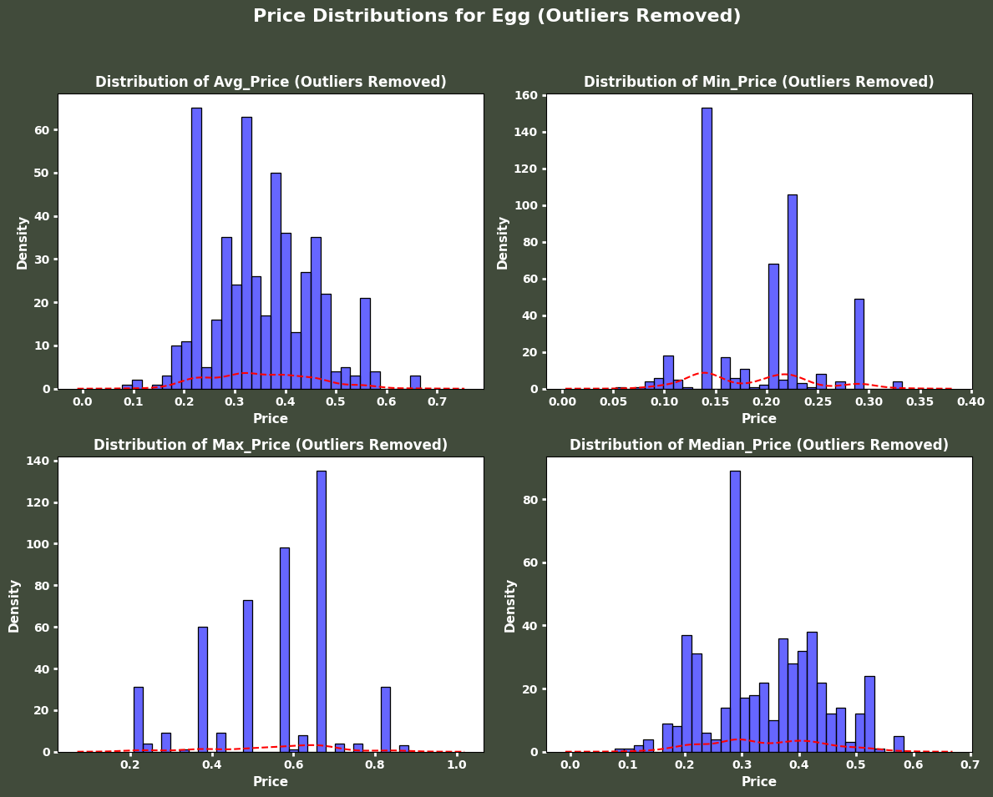
Egg Pricing
Distribution
Avg Price Distribution (Top Left)
Prices cluster around $0.30–$0.40 per egg.
This is below the national average of $0.49, suggesting Kroger offers strong value, with fewer stores at or above the national rate.
Min Price Distribution (Top Right)
Minimum prices are concentrated around $0.15–$0.20.
Budget-conscious shoppers can find low-cost options in most zip codes.
Max Price Distribution (Bottom Left)
Prices vary widely, peaking around $0.65.
This is ~33% above the national average and 65% above Kroger’s store average, likely reflecting premium offerings.
Median Price Distribution (Bottom Right)
Multiple peaks in the density function suggest distinct price groupings.
This may reflect different Kroger-affiliated chains offering varied price points.

Slide 10
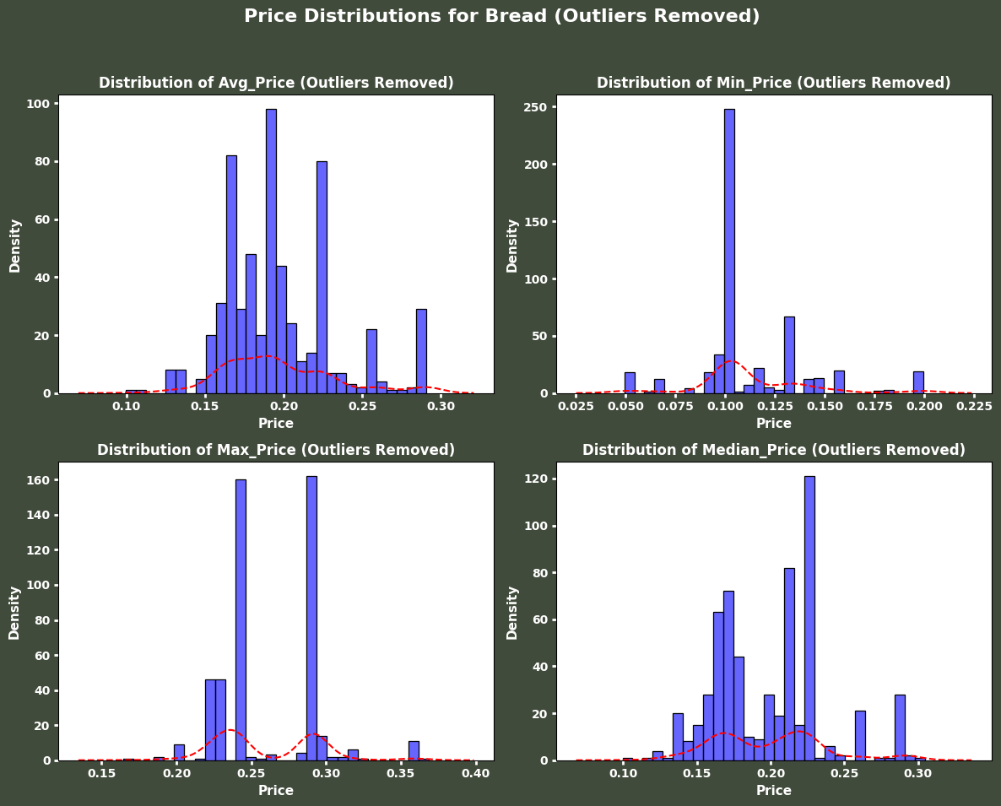
Bread Pricing
Distribution
Avg Price Distribution (Top Left)
Prices cluster around $0.15–$0.25 per ounce, above the national average of $0.12.
This suggests Kroger’s bread prices are generally higher, potentially due to premium or branded options.
Min Price Distribution (Top Right)
Minimum prices are concentrated around $0.10–$0.12, aligning closely with the national average.
Budget-friendly options exist but are not the majority.
Max Price Distribution (Bottom Left)
Prices vary widely, with peaks around $0.25 and $0.30 per ounce, significantly above the national average.
The dual peaks may indicate basic vs. premium product segmentation.
Median Price Distribution (Bottom Right)
The median price follows a similar pattern to the average price, clustering around $0.15–$0.25.
Multiple peaks suggest price differentiation between store brands and name brands.

Slide 11
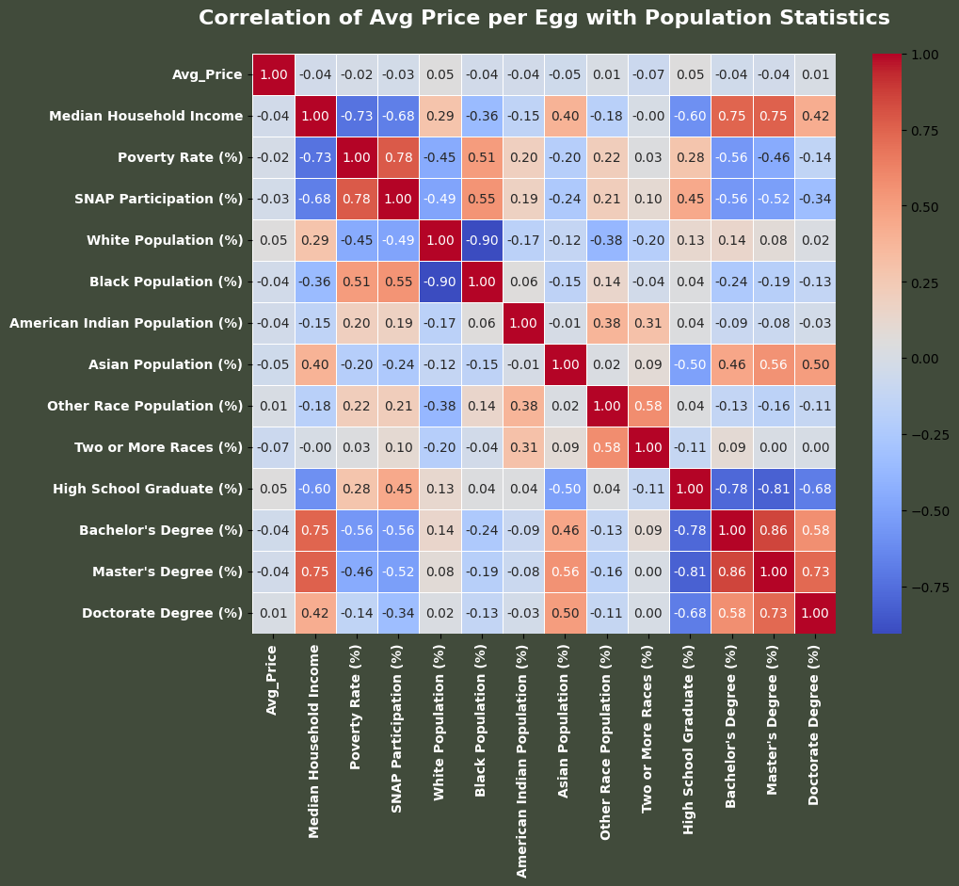
Egg Correlation Matrix
Income Characteristics
No correlation between income, poverty rate, SNAP participation, and Avg Price.
Suggests stable pricing across income levels or similar economic profiles in Kroger locations.
Racial / Ethnic Characteristics
No significant correlation between any racial or ethnic characteristics and avg pricing.
Suggests that pricing is static regardless of market, and potentially set through national vendor contracts.
Education Characteristics
No significant correlation between education levels and Avg Price.
Since income and education are linked, pricing likely remains independent of socioeconomic factors.

Slide 12
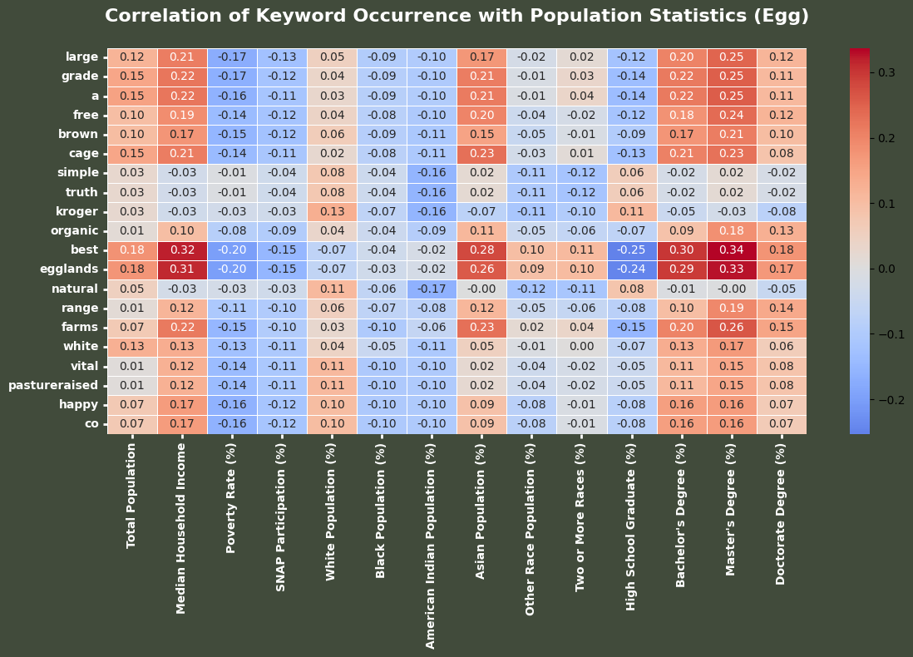
Egg Keyword Correlation Matrix
Income Characteristics
Premium brands ("Best" 0.32, "Eggland’s" 0.31) and descriptive terms ("Cage," "Free," "Farms") correlate with higher income, suggesting wealthier areas favor premium eggs.
Racial / Ethnic Characteristics
White & Asian populations show positive correlations with premium-related keywords ("Best," "Cage," "Organic," "Pastureraised").
Other racial/ethnic groups show neutral or negative correlations.
Education Characteristics
Education, income, and Asian population show similar correlations with premium keywords, reinforcing a shared trend.

Slide 13
Exploratory Data Analaysis: Summary
Pricing Consistency: Egg prices remain relatively stable across all locations, suggesting flat pricing strategies rather than income-based adjustments.
Demographic Influence on Product Mix: Wealthier and more educated areas see higher availability of premium brands (e.g., "Best," "Eggland’s", “Vital”) and attributes like cage-free, organic, and pasture-raised.
Racial & Ethnic Trends: White and Asian populations show stronger correlations with premium offerings, while other groups exhibit neutral or negative correlations.
Key Takeaway: Kroger doesn’t adjust pricing based on demographics but tailors product selection to match local demand for premium vs. budget options.

Slide 14
Issues and Limitations
Location Data Corrections
Incorrect ZIP codes in initial data led to misassigned locations.
Solution: Google Maps API was used to validate ZIP codes, latitude, and longitude.
Data Pipeline Automation
Initially developed in Jupyter Notebook, later refactored into modular Python scripts.
Integrated with GitHub Actions for automated daily updates.
Missing Product Information
Some locations lacked product data and were excluded from the analysis.
Future updates will ensure all locations have complete product listings.
Dataset Size & Completeness
The dataset does not yet cover all Kroger locations.
Expanding coverage will enhance pricing accuracy and product availability tracking.

Slide 15
Data Rights and Access
Access Controls:
Data retrieval via OAuth-secured API authentication.
Rate limits enforced; API token automatically refreshed as needed.
Data stored in structured repositories for controlled access.
Data Privacy & Usage Restrictions:
Census data is public but aggregated to prevent individual identification.
Kroger API data requires an access token and adheres to usage policies.
No Personally Identifiable Information (PII) is collected, ensuring data ethics compliance.
Distribution Plan:
Final dataset stored in a public GitHub repository.
Structured in CSV format for seamless integration into analysis tools.
Access to raw API data restricted to comply with Kroger’s data policies.
Future Consideration:
Re-automate data pipeline for scheduled updates.
Explore BigQuery as a scalable data warehouse for efficient storage and querying.
Utilize Looker Studio to develop public-facing dashboards for automated insights.

Slide 16
Conclusion
Main Takeaways
Pricing trends: Kroger maintains stable prices across locations.
Product availability & demographics: Higher-income areas see more premium products (organic, cage-free).
Retail strategy insight: Kroger doesn’t price-discriminate but adjusts inventory mix based on demand.
Challenges & Limitations
Incomplete store coverage due to missing product data.
Need for more ZIP code-level granularity for deeper insights.
API Rate Limits affecting frequency of updates.
Extensive data corrections were required due to incorrectly assigned ZIP codes and data type inconsistencies, impacting location accuracy and requiring additional validation steps.
Next Steps
Expand product categories beyond eggs & bread.
Automate real-time price tracking for inflation analysis.
Enhance geospatial analysis by adding grocery store density maps.

Slide 17
Thank You!

